Slide 1



Slide 2
Data Types
data type: a collection of values and the definition of one or more operations that can be performed on those values
C++ includes a variety of built-in or base data types:
short, int, long, float, double, char, etc.
The values are ordered and atomic.
C++ supports several mechanisms for aggregate data types: arrays, structures, classes.
These allow complex combinations of other types as single entities.
C++ also supports other mechanisms that allow programmers to define their own custom data types: enum types and typedefs.
Notes:
CS 1044 Intro Programming in C++ Fall 2002
User Defined Types
We have covered all of the built-in types that we will see in CS 1044.
We have already examined arrays and will examine structures in the next chapter. Classes are deferred until CS 1704.
In this chapter, we will examine enumerated types and typedefs in some detail.

Slide 3
Enumeration
Enumeration is a user-defined data type. It is defined using the keyword enum and the syntax is:
  enum tag_name {name_0, …, name_n} ;
The tag_name is not used directly. The names in the braces are symbolic constants that take on integer values from zero through n. As an example, the statement:
  enum colors { red, yellow, green } ;
creates three constants. red is assigned the value 0, yellow is assigned 1 and green is assigned 2.
Notes:
Engineering H192
Winter 2005
Lecture 23
Instructor:
Enumeration is essentially a method of creating a numbered list. It allows the user to assign names to numbers which can then be used as indices in an array. An example is given on the next two slides.

Slide 4
enum - Enumeration Constants
The values in an enumstart with 0, unless specified otherwise, and are incremented by 1. For example, the following enumeration,
enum days {Mon, Tue, Wed, Thu, Fri, Sat, Sun};
Creates a new data type, enum days, in which the identifiers are set automatically to the integers 0 to 6.
To number the days 1 to 7, use the following enumeration,
enum days {Mon = 1, Tue, Wed, Thu, Fri, Sat, Sun};
Or we can re-arrange the order,
enum days {Mon, Tue, Wed, Thu = 7, Fri, Sat, Sun};

Slide 5
#include <iostream>
using namespace std;
enum week { Sunday, Monday, Tuesday, Wednesday, Thursday, Friday, Saturday };
int main()
{
week today;
today = Friday;
cout << "Day " << today;
return 0;
}

Slide 6
#include <iostream>
using namespace std;
enum Choice
{ EASY = 1, MEDIUM = 2, HARD = 3
};
int i = -1;
int main()
{
cin >> i;
switch(i)
{
case EASY:
cout << "Easy\n";
break;
case MEDIUM:
cout << "Medium\n";
break;
case HARD:
cout << "Hard\n";
break;
default:
cout << "Invalid Selection\n";
break;
}
return 0;
}

Slide 7
#include <iostream>
using namespace std;
enum week { Sunday, Monday, Tuesday, Wednesday=6, Thursday, Friday, Saturday };
int main()
{
week today;
today = Friday;
cout << "Day " << today;
return 0;
}

Slide 8
#include <bits/stdc++.h>
using namespace std;
int main()
{
// Defining enum Gender
enum Gender { Male, Female };
// Creating Gender type variable
Gender gender = Male;
switch (gender)
{
case Male:
cout << "Gender is Male";
break;
case Female:
cout << "Gender is Female";
break;
default:
cout << "Value can be Male or Female";
}
return 0;
}

Slide 9
Enumerated Types
An enumerated type is defined by giving a name for the type and then giving a list of labels, which are the only values that a variable of that type is allowed to have.
Enumerated types allow the creation of specialized types that support the use of meaningful labels within a program. They promote code readability with very little overhead in memory or runtime cost.
enum Month {JAN, FEB, MAR, APR, MAY, JUN,
JUL, AUG, SEP, OCT, NOV, DEC};
enum Season {WINTER, SPRING, SUMMER, FALL};
enum Hemisphere {NORTH, SOUTH, EAST, WEST};
Month Mon;
Season Period;
Hemisphere Region;
. . .
if (Mon == JAN && Region == NORTH)
Period = WINTER;
An enumerated type is allowed to have up to 256 values and a variable of an enumerated type will occupy one byte of memory.
It is an error for the same label to be listed as a value for two different enumerated types.
Notes:
CS 1044 Intro Programming in C++ Fall 2002
User Defined Types
Internally enum labels are stored as 8-bit integers (range 0 to 255). By default the labels are represented by sequential values, starting with 0, assigned in the order the labels are listed.
It is possible to control what numeric value is used to represent each label, but doing so violates the basic spirit of the language feature. What is important is the logical significance of the labels, not the internal representation.

Slide 10
Designing with Enumerated Types
Enumerated types provide a mechanism for the abstraction of real world entities.
Enumerated type variables do not contain the character string of the value. The internal representation uses integer values; it is bad practice to rely on those values.
Since the labels are logically constant values it is common to express them using all capital letters, just as for named constants.
Enumerated type values cannot be read or (usefully) written directly.
Enumerated type variables and values can be used in relational comparisons, in assignments and in switch statements as selectors and case labels.
Enumerated type variables can be passed as parameters and used as the return value of a function.
Good use of enumerated data types make the program more readable by providing a way to incorporate meaningful labels (thus easier to debug) and they help in self-documenting the program.
Notes:
CS 1044 Intro Programming in C++ Fall 2002
User Defined Types

Slide 11
Integer Parity Check
enum ParityType {EVEN, ODD}; // file-scoped type definition
ParityType FindParity(int N);
int main() {
int k;
ParityType kParity;
cout << "Please enter an integer: "; // get an integer
cin >> k;
kParity = FindParity(k); // determine its parity
if (kParity == EVEN) // can’t usefully print
cout << "That was even." << endl; // the value of kParity
else // directly
cout << "Hmmm... that was odd." << endl;
return 0;
}
ParityType FindParity(int N) {
if (N % 2 == 0)
return EVEN;
else
return ODD;
}
Notes:
CS 1044 Intro Programming in C++ Fall 2002
User Defined Types
This is sort of artificial, but it illustrates using an enum type in comparisons and assignment and function return.
Note that the type definition is at global scope… this is typical of most type definitions and necessary because the type is used in two independent scopes (main and FindParity).
No special header is needed to use an enum type.

Slide 12
Other Uses of enum Types
Since an enumerated type is represented in hardware by integer values, enum variables may be used as switch selectors and as array indices:
string parityToString(ParityType Parity) {
const int NUMPARITYVALUES = 2;
const string parityLabel[NUMPARITYVALUES] = {"even", "odd"};
if ( int(Parity) >= NUMPARITYVALUES ) {
return "unknown";
}
return parityLabel[Parity];
}
User input strings can be represented internally using an enumerated type:
enum editCommand {INSERT, DELETE, MARKBEGIN, MARKEND, . . ., EXIT,
EDITUNKNOWN};
. . .
editCommand getCommand(ifstream& In) {
string userEntry;
getline(In, userEntry, '\t');
if ( userEntry == "insert" ) return INSERT;
if ( userEntry == "delete" ) return DELETE;
. . .
return EDITUNKNOWN;
}
Notes:
CS 1044 Intro Programming in C++ Fall 2002
User Defined Types
The second example is a fairly common way of handling script-driven input, since strings cannot be used as switch selectors and switch statements are a natural technique for processing script logic.

Slide 13
typedef Statements
The typedef statement allows a programmer to define custom types by creating an "alias" for an existing type:
typedef <predefined type> <alias>;
For example:
typedef string PlaceName;
typedef int Vector3D[3];
void Reverse(Vector3D X) {
X[0] = -X[0];
X[1] = -X[1];
X[2] = -X[2];
}
Typedefs allow the programmer to map existing data types to a problem-specific names.
Good use of typedefs can improve data organization.
Correct application of typedefs aids in the production of self-documenting code.
… but no useful additional type-checking is enabled.
Notes:
CS 1044 Intro Programming in C++ Fall 2002
User Defined Types
QUESTION: does a typedef accomplish anything other than an aliasing effect? My Vector3D example shows that type checking is not reliable with a typedef.
Bottom line is that a typedef merely creates an alias… readability may be enhanced but little else is gained.
Proper use of struct and class types is far more beneficial.

Slide 14
Organizing Heterogeneous Data
Arrays allow a programmer to organize lists of values that are all of the same type (homogeneous).
But we are often faced with data values of differing types (heterogeneous) that are logically related, as we have seen earlier with trip data:
Origin Destination Miles Time
----------------------------------------------------------
Blacksburg, VA Knoxville, TN 244 3:25
Knoxville, TN Nashville, TN 178 2:35
Nashville, TN Memphis, TN 210 3:17
Memphis, TN Little Rock, AR 137 2:05
Little Rock, AR Texarkana, TX 141 2:10
While we can organize this data using parallel arrays, that is unsatisfying because we have then distributed the logically related values for a single trip across several different data structures.
A better design would be to have a new data type Trip such that a variable of type Trip would contain all the related values for a single trip.
The struct mechanism allows C++ programmers to do just that…
Notes:
CS 1044 Intro Programming in C++ Fall 2002
Structures
The struct is the most powerful data type mechanism we cover in CS 1044. It leads naturally to the notion of a class in CS 1704.

Slide 15
Structures
structure - a heterogeneous collection of data values called members or fields
- each member has a type and a unique name
- individual members are accessed by name
The definition of a structured type specifies the type name as well as the types and names of each of the members:
struct Trip {
string Origin; // starting point of trip
string Destination; // ending point of trip
int Miles; // distance traveled
int Minutes; // time required, in min
double MPH; // average speed
};
Trip firstLeg;
const int MAXLEGS = 100;
Trip Itinerary[MAXLEGS]; // array of Trips
Notes:
CS 1044 Intro Programming in C++ Fall 2002
Structures
struct is a C++ reserved word.
There are two definition syntaxes:
struct Foo {
// body
};
typedef struct {
// body
} Foo;
I strongly suggest avoiding the latter. The former corresponds to class definition syntax (the latter cannot be used there), and our students may as well get used to recognizing that that's a type definition.

Slide 16
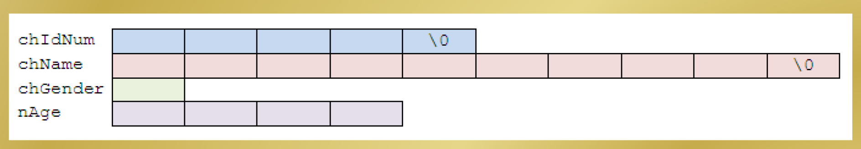
Example Struct
To store and process a student’s record with the elements chIdNum(identification number), chName, chGenderand nAge,
We can declare the following structure :
struct student{
char chIdNum[5];
char chName[10];
char chGender;
int nAge;
};
The previous sample template for the structure can be illustrated as follow (note the different data sizes),

Slide 17
Definition of a structure:
struct <struct_name>{
<type> <variable_name>;
<type> <variable_name>;
...
} ;
Example:
struct employee {
int emp_id;
char name;
float salary;
} ;

Slide 18
Define, declare and initialize Struct
// declare a structure
struct StudentRecord{
char Name[22];
int Id;
char Dept[22];
char Gender;
};
// declare a structure
struct StudentRecord{
char Name[22];
int Id;
char Dept[22];
char Gender;
} newStudent ;
Define the structure
Declare the variabel of structure
struct StudentRecord student1; newStudent.Name;

Slide 19
Struct Typedef
All the structure program examples in the previous structure section can be simplified using typedef.
The typedef keyword can be used to create a synonym for a data type. It is most often used to simplify the naming and use of record types (i.e., structure types).
Define the typedef
Declare the variabel of structure
Struct StudentRecord student1; newStudent student1;
// declare a structure
typedef struct StudentRecord{
char Name[22];
int Id;
char Dept[22];
char Gender;
};
// declare a structure
Typedef struct {
char Name[22];
int Id;
char Dept[22];
char Gender;
} newStudent;

Slide 20
Accessing struct members
The member selection operator (.) is used between the variable name and the member identifier to access individual members of a struct type variable.
EXAMPLES
student1.Name;
student1.Id;
student1.Dept;
student1.Gender;

Slide 21

student1.Name = “Silmi Fauziati “;
student1.Id = 1234;
student1.Dept = “Technology Informaion”;
student1.Gender = ‘F’;
printf (“The name of student is : %s”, student1.Name);
printf (“The ID of student is : %d”, student1.Id);
printf (“The Department of student is : %s”, student1.Dept);
printf (“The Gender of student is : %c”, student1.Gender);
☺

Slide 22
#include <iostream>
using namespace std;
struct employee
{
int emp_id;
char name[20];
float salary;
};
int main()
{
struct employee e1;
cout << "Enter id Employee: \n";
cin>> e1.emp_id;
cout << "Enter Name: \n";
cin >> e1.name;
cout << "Enter salary: \n";
cin >> e1.salary;
cout << "\nDisplaying Information." << endl;
cout << "ID: " << e1.emp_id << endl;
cout <<"Name: " << e1.name << endl;
cout << "Salary: " << e1.salary;
return 0;
}

Slide 23
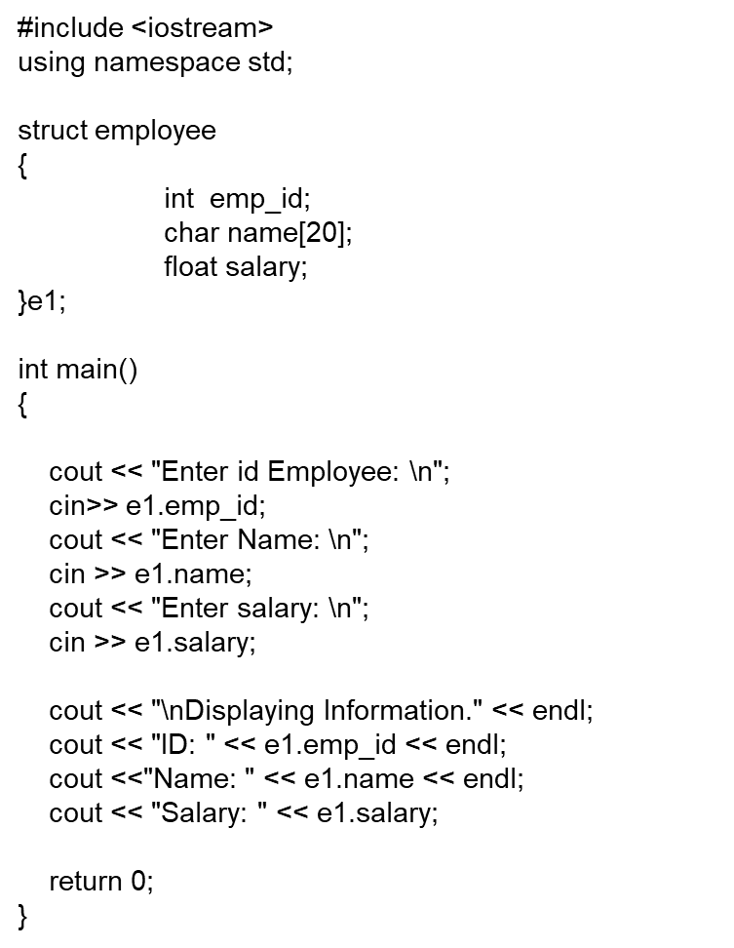
#include <iostream>
using namespace std;
struct employee
{
int emp_id;
char name[20];
float salary;
}e1;
int main()
{
employee e1;
cout << "Enter id Employee: \n";
cin>> e1.emp_id;
cout << "Enter Name: \n";
cin >> e1.name;
cout << "Enter salary: \n";
cin >> e1.salary;
cout << "\nDisplaying Information." << endl;
cout << "ID: " << e1.emp_id << endl;
cout <<"Name: " << e1.name << endl;
cout << "Salary: " << e1.salary;
return 0;
}

Slide 24
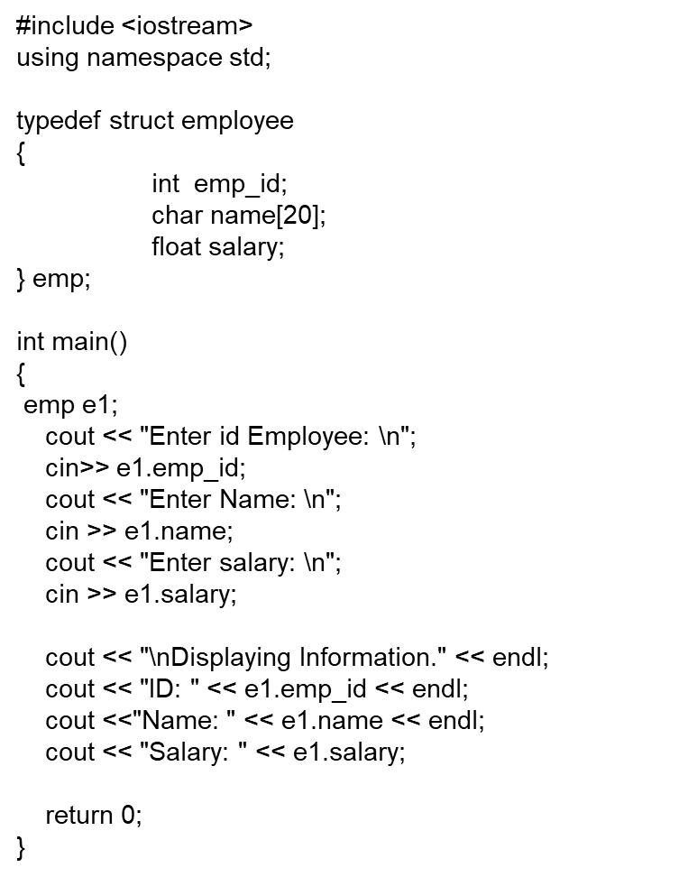
#include <iostream>
using namespace std;
typedef struct
{
int emp_id;
char name[20];
float salary;
} emp;
int main()
{
emp e1;
cout << "Enter id Employee: \n";
cin>> e1.emp_id;
cout << "Enter Name: \n";
cin >> e1.name;
cout << "Enter salary: \n";
cin >> e1.salary;
cout << "\nDisplaying Information." << endl;
cout << "ID: " << e1.emp_id << endl;
cout <<"Name: " << e1.name << endl;
cout << "Salary: " << e1.salary;
return 0;
}

Slide 25
struct Variables
A variable of a struct type will contain the values for all of the specified members for that type. Of course, the values of those members will just be random garbage until they have been properly initialized. Assuming we've initialized the members of the variable firstLeg, we would have a memory layout something like this:
Trip firstLeg;
In memory:
Blacksburg, VA
Knoxville, TN
244
205
71.2
To reference a particular member of a struct variable, state the variable name followed by a period followed by the member name:
firstLeg.Origin = "Blacksburg, VA";
firstLeg.Destination = "Knoxville, TN";
firstLeg.Miles = 244;
firstLeg.Minutes = 205;
firstLeg.MPH = 71.2;
The period is called the member selector operator.
Notes:
CS 1044 Intro Programming in C++ Fall 2002
Structures
There was a pernicious typo here in the Fall 2000 edition. The two uses of "anItem" in the first code box were incorrectly given as "Item".

Slide 26
Member Access Example
The members of a struct variable may be used just as if they were simple variables of the specified type.
enum Color {RED, GREEN, BLUE, NOCOLOR};
struct Rectangle {
Color Hue;
int xNW,
yNW;
int Side[4];
};
. . .
Rectangle R;
cin >> R.xNW >> R.yNW;
cin >> R.Side[0] >> R.Side[1] >> R.Side[2] >> R.Side[3];
R.Hue = NOCOLOR;
int Area = R.Side[0] * R.Side[1];
Notes:
CS 1044 Intro Programming in C++ Fall 2002
Structures
The convention here is that the (lengths of the) sides are stored in clockwise order, starting at the NW corner.
Discuss the use of an array as a member of the struct type Rectangle. The syntax should make sense logically:
R1.Side[Idx] is interpreted as:
R1 is the name of a variable of type Rectangle
R1.Side is the name of an array that is a member of R1
R1.Side[Idx] is the name of a particular cell of that
array

Slide 27
Aggregate Operations
An aggregate operation is an operation that is performed on a data structure, such as an structured variable, as a whole rather than performed on an individual member.
Assume the following declarations:
Trip X, Y;
Assuming that both X and Y have been initialized, consider the following statements and expressions involving aggregate operations:
X = Y; // _____ assigning one struct to another
X == Y; // _____ comparing two structs with a relational operator
cout << X; // _____ inserting an struct to a stream
X + Y // _____ performing arithmetic with structs
return X; // _____ using a struct as the return value from a function
Foo(X); // _____ passing an entire struct as a parameter
Of course, the operations that are not supported by default may still be implemented via user-defined functions.
Notes:
CS 1044 Intro Programming in C++ Fall 2002
Structures
Answers:
Assignment: Yes.
(There is a shallow copy issue, but it can be safely ignored in this course.)
Comparison: No
I/O: No, and it wouldn't be terribly useful anyway.
Arithmetic: Not even if it makes sense.
Return: Yes. (Even if a data member is an array – may seem schizoid* but true.)
Parameter: Yes. (Default mode is by value.)
It's a useful exercise to write a couple of functions at this point. There are a couple coming up in the notes.
* this works as desired because the size of the struct variable is fixed (we assume static allocation throughout) and so there is no potential confusion regarding the size of either the source array or the target array.

Slide 28
struct Variables as Parameters
Entire struct variables can be passed to functions as parameters. By default is struct is passed by value.
For example:
void setMPH(Trip& aTrip) {
aTrip.MPH = MINPERHOUR * double(aTrip.Miles) / aTrip.Minutes;
}
Since struct variables tend to be large, it is generally better to pass them by constant reference than by value if possible:
void printTrip(ofstream& Out, const Trip& aTrip) {
Out << left << setw(MAXNAMELENGTH + 1) << aTrip.Origin
<< setw(MAXNAMELENGTH + 1) << aTrip.Destination
<< right << setw(10) << aTrip.Miles
<< setw(10) << (aTrip.Minutes / MINSPERHOUR) << ':'
<< setfill('0') << setw(2) << (aTrip.Minutes % MINSPERHOUR)
<< setfill(' ') << setw(10) << setprecision(1)
<< aTrip.MPH
<< endl;
}
Notes:
CS 1044 Intro Programming in C++ Fall 2002
Structures

Slide 29
Implementing struct Operations
A programmer can implement any needed operations that are not supported automatically:
bool areSame(const Trip& T1, const Trip& T2) {
if ( (T1.Origin == T2.Origin) &&
(T1.Destination == T2.Destination) ) {
return true;
}
return false;
}
Note that the meaning of equality for trips must be defined. Here we require the trips to have the same starting and ending points. Other definitions could also make sense; it depends on the context.
bool isFaster(const Trip& T1, const Trip& T2) {
return (T1.MPH < T2.MPH);
}
Trip reverseTrip(const Trip& T) {
Trip Reverse = T;
Reverse.Origin = T.Destination;
Reverse.Destination = T.Origin;
return (Reverse);
}
Notes:
CS 1044 Intro Programming in C++ Fall 2002
Structures

Slide 30
Array of Structures
In most applications of struct types, an array (or some other data structure) is used to organize a collection of individual struct variables.
An array of structures provides an alternative to using a collection of parallel arrays:
0 | Blacksburg, VA Knoxville, TN 244 205 ??
1 | Knoxville, TN Nashville, TN 178 155 ??
 | . . .
4 | Little Rock, AR Texarkana, AR 141 160 ??
 | . . .
const int MAXTRIPS = 500;
Trip Itinerary[MAXTRIPS];
Of course, to refer to a member of one of the struct variables in the array we must combine array syntax with struct syntax.
To set the first array element would require the syntax:
Itinerary[0] = firstLeg;
To set the MPG member of the fifth struct variable would require the syntax:
Itinerary[4].MPG = 52.88;
Notes:
CS 1044 Intro Programming in C++ Fall 2002
Structures
Contrast this with the corresponding parallel array example in the array chapter. Using an array of structures instead offers several advantages, including:
simplified function parameter lists, only one array to be passed instead of several
physically all relevant data is stored in a single data structure, eliminating concerns about keeping corresponding data straight via uniform index use
The syntax for member access here is straightforward if you simply think about it logically:
Itinerary is the name of an array (of structures)
Itinerary[Idx] is the name of an element of the array (which is a struct of type Trip)
Itinerary[Idx].MPG is the name of a member of that struct variable.

Slide 31
Designing with Structures
Structured types allow the creation of specialized data types which better model the logical relationships among the data values being stored and manipulated.
This allows the designer to consider the problem from a higher, more natural, level.
For example, we may design the step "print a trip" and defer the details of that until a later refinement of the design. Of course, we may do that without structured types, but the use of structured types encourages designers to think at that level.
Using a structured type may also promote code reuse if the type is suitable for inclusion in independent applications. The Trip type presented in these notes could be relevant to a number of different programs.
Properly speaking, a data type is a collection of values and the operations that may be performed on them. For a struct type, most of these operations will be implemented in separate user-defined functions, and those may also be recyclable into other applications.
Notes:
CS 1044 Intro Programming in C++ Fall 2002
Structures
Of course, we're really trying to build up to the notion of an ADT; that's not formally introduced until CS 1704.

Slide 32
Application: the Trip Program Revisited
Consider implementing the simple trip program using an array of structures to organize the trip data.
Clearly we may use an array of Trip variables, as defined earlier, to store the data:
Origin Destination Miles Time
----------------------------------------------------------
Blacksburg, VA Knoxville, TN 244 3:25
Knoxville, TN Nashville, TN 178 2:35
Nashville, TN Memphis, TN 210 3:17
Memphis, TN Little Rock, AR 137 2:05
Little Rock, AR Texarkana, TX 141 2:10
. . .
By using an array of structures we will be able to implement the same operations as with a collection of parallel arrays, but the data organization will be much simpler. Almost all of the functions will have much simpler parameter lists.
We will consider portions of such an implementation here.
Notes:
CS 1044 Intro Programming in C++ Fall 2002
Structures
This is the basis for a fairly standard terminal CS 1044 project.
There should be a complete formal specification on the course website by the time these notes are reached, and a formal design analysis, as well as the complete source code for a working implementation.
The following slides will present portions of that implementation, along with some design discussion.

Slide 33
The Overall Organization
Since the data is all encapsulated in a single array of structures we achieve a very simple overall design:
int main() {
Trip Itinerary[MAXTRIPS]; // list of trip data
int numTrips = 0; // number of trips reported.
numTrips = readTripData(Itinerary); // Read the given trip data.
// Calculate the average MPH for each of the trips:
calcAllMPH(Itinerary, numTrips);
// Calculate the statistics for the summary report:
int totalMiles, totalMinutes;
double overallMPH;
calcStats(Itinerary, numTrips, totalMiles, totalMinutes, overallMPH);
// Write output file:
writeReport(Itinerary, numTrips, totalMiles, totalMinutes, overallMPH);
return 0; // Terminate a successful execution.
}
Notes:
CS 1044 Intro Programming in C++ Fall 2002
Structures
Note the simplicity of the design of main(). Essentially we have an input section, a calculation section, and an output section. Each of those delegates all details to one or more subsidiary functions.
(This should be the same as when parallel arrays were used. The gain here is that there are a LOT fewer function parameters to keep track of.)
main() declares only those variables that are needed to store data used in two or more of these subsidiary functions.
We maintain a separation of calculation from input and output because that promotes clarity. It would be possible to delegate the calculations for the summary report to the output code, simplifying the structure of main() somewhat. IMO that's a poor tradeoff.

Slide 34
Managing Structured Input
Logically, reading and storing the trip data is relatively straightforward, given our earlier discussions. However, the syntax for using an array of struct variables bears examination:
int readTripData(Trip List[]) {
int tripsRead = 0; // counter for trips
ifstream In(dataFileName.c_str()); // Open the input file.
// If the input file does not exist, this will detect that.
// We handle that by printing an error message and stopping the program.
if ( In.fail() ) {
cout << "Data file not found: " // Write an error message...
<< dataFileName // including the file name.
<< endl // Bang "return"
<< "Exiting now..." << endl; // Finish the message.
exit(1); // Terminate a failed execution.
}
// . . . continues on next slide . . .
Notes:
CS 1044 Intro Programming in C++ Fall 2002
Structures
Note that, compared to the parallel array example earlier in the notes, the input manager function has only a single array parameter.
We assume that the input file name is a global constant, rather than hard-wiring it locally. That makes modification somewhat easier.
The call would resemble: numTrips = readTripData(Itinerary);

Slide 35
Managing Structured Input
Here is the input management code. Note the use of a local Trip variable to "buffer" the input and the use of a helper function:
// . . . continued from preceding slide . . .
In.ignore(INT_MAX, '\n'); // Skip over the two header lines in the
In.ignore(INT_MAX, '\n'); // trip data input file.
Trip nextTrip;
nextTrip = readOneTrip(In); // Try to read data for a trip.
while ( In && (tripsRead < MAXTRIPS) ) {
List[tripsRead] = nextTrip; // Store the trip that was just read
tripsRead++; // . . . and count it.
nextTrip = readOneTrip(In); // Try to read data for another trip.
}
In.close();
return tripsRead; // Tell the caller how many trips were read.
}
Notes:
CS 1044 Intro Programming in C++ Fall 2002
Structures
We’ve discussed the importance of "buffering" input data before committing it to a data structure already… this is a good place to remind them.
The use of a "helper" function allows us to isolate (most of) the design logic that depends upon the specific formatting of the input data.
Note the use of an aggregate assignment to copy the returned Trip variable into an array cell. This could be done member-by-member but that would require writing more code (for no reason), inviting the introduction of logical errors (such as switching origin and destination).

Slide 36
Reading the Structured Record
Here we read and return data for a single trip:
Trip readOneTrip(ifstream& In) {
Trip newTrip; // Trip variable to "bundle" the data
int tripHours, tripMinutes;
getline(In, newTrip.Origin, '\t'); // Read: the name of the trip origin.
getline(In, newTrip.Destination, '\t'); // and the trip destination.
In >> newTrip.Miles; // the length of trip in miles
In >> tripHours; // hours field for trip time
In.ignore(1, ':'); // colon separator
In >> tripMinutes; // minutes field for trip time
newTrip.Minutes = convertHHMMtoMin(tripHours, tripMinutes);
In.ignore(INT_MAX, '\n'); // Skip to beginning of next input line.
return newTrip; // Return a copy of the Trip variable to the caller.
}
Notes:
CS 1044 Intro Programming in C++ Fall 2002
Structures
We’ve discussed the importance of "buffering" input data before committing it to a data structure already… this is a good place to remind them.
The use of a "helper" function allows us to isolate (most of) the design logic that depends upon the specific formatting of the input data.

Slide 37
Managing Updates to the Array
The input code does not update the Trip records to include the average speed. This function manages that. Note the use of another helper function.
void calcAllMPH(Trip Itinerary[], int numTrips) {
int Idx;
for (Idx = 0; Idx < numTrips; Idx++) {
Itinerary[Idx].MPH = calcMPH(Itinerary[Idx].Miles,
Itinerary[Idx].Minutes);
}
}
As usual, we have a for loop to traverse the data array so we can process its cells one-by-one.
The caller "extracts" the appropriate members of the current Trip variable and passes them to the helper function.
double calcMPH(int Miles, int Minutes) {
return (MINPERHOUR * double(Miles) / double(Minutes));
}
Notes:
CS 1044 Intro Programming in C++ Fall 2002
Structures
Point out the actual parameters in the call to the helper function calcMPH(). The helper function expects an integer distance and an integer time value: whether they are bundled within a structure on the calling side is of no interest to the the helper function (note the formal parameters).
There is, I suppose, ALMOST a weak "pattern" here in that the top-level function handles selecting the data elements (in some order) from the data structure and passing them to a helper function which understands the internal structure/logic of those elements. The point would be clearer if calcMPH() took an entire Trip as a parameter…

Slide 38
Alternative Implementation
The preceding implementation is correct but it requires both functions to incorporate information about the internal structure of a Trip variable. Here is a revision that makes the top-level function relatively unaware of those internals.
void calcAllMPH(Trip Itinerary[], int numTrips) {
int Idx;
for (Idx = 0; Idx < numTrips; Idx++) {
setMPH(Itinerary[Idx]);
}
}
Now the caller simply passes an entire data element of the array to its helper function.
The caller has no need to "know" anything about the internal organization of a Trip variable.
That's all encapsulated within the helper function now.
void setMPH(Trip& T) {
T.MPH = MINPERHOUR * double(T.Miles) / double(T. Minutes);
}
Notes:
CS 1044 Intro Programming in C++ Fall 2002
Structures
Now the aforementioned pattern is clear. This notion, of separating the traversal logic from the processing logic is a fairly important one in later courses. Either approach will work, but this achieves a separation that promotes generality. The implementation of calcAllMPH() could be recycled to handle other updates to the list of Trip variables by simply renaming the function and calling a different helper.

Slide 39
Writing the List to File
Compare the top-level function here to calcAllMPH(). See a "pattern"?
void writeTripData(ofstream& Out, const Trip Itinerary[], int numTrips) {
int Idx;
for (Idx = 0; Idx < numTrips; Idx++) {
writeOneTrip(Out, Itinerary[Idx]);
}
}
Note the two uses of pass by constant reference to prevent unnecessary modification of data.
void writeOneTrip(ofstream& Out, const Trip& toPrint) {
Out << left << setw(MAXNAMELENGTH + 1) << toPrint.Origin;
Out << setw(MAXNAMELENGTH + 1) << toPrint.Destination;
Out << right << setw( 7) << toPrint.Miles
<< setw(10) << toPrint.Minutes
<< setw( 8) << setprecision(1) << toPrint.MPH
<< endl;
}
Notes:
CS 1044 Intro Programming in C++ Fall 2002
Structures
The body of the top-level function here is essentially isomorphic to the earlier one… that's the "traverse and hand off" pattern again.
(That's not an "official" name… I'm sure there is one.)
The array of structs is passed by constant reference because writing its contents should not modify it. The individual Trip variables are passed to the helper function by constant reference instead of by value primarily to avoid the expense of making a copy.

Slide 40
Hierarchical Organization
In some cases a designer will plan a structured type with members that are also reasonably considered to be structured themselves.
For example, we might reconsider the design of the Trip type to allow a more useful description of the origin and destination. Logically each of these is just a "place" which we might consider to be represented by a city name and a state abbreviation:
struct Place{
string City;
string State;
};
struct Trip {
Place Origin;
Place Destination;
int Miles;
int Minutes;
double MPH;
};
This approach provides two custom data types, instead of one. Variables of type Place might well be useful in other applications.
Hierarchical organization is often designed as a natural way to take advantage of already-existing custom types.
Of course a hierarchical organization also requires slightly more complex syntax when accessing the members of a structured member.
Notes:
CS 1044 Intro Programming in C++ Fall 2002
Structures
Hierarchical organization is often referred to as (a type of) aggregation.
Using a struct hierarchy well promotes code reuse (or type reuse), and improves the logical organization of data.
Once we get to classes in 1704 and especially 2704 the notion of hierarchy becomes much more powerful since the type will include its own operations.

Slide 41
Member Access in a Hierarchy
The usual syntax rules apply. It's just a matter of keeping straight exactly what the syntax means. Given the type definitions from the previous slide:
Trip toSmithsonian;
toSmithsonian.Origin.City = "Blacksburg";
toSmithsonian.Origin.State = "VA";
. . .
toSmithsonian.Miles = xxx;
toSmithsonian.Minutes = xxx;
. . .
Alternatively we could use an aggregate assignment to set the Place members of our Trip variable:
Place WashDC;
WashDC.City = "Washington";
WashDC.State = "DC";
Trip toSmithsonian;
toSmithsonian.Destination = WashDC;
. . .
Notes:
CS 1044 Intro Programming in C++ Fall 2002
Structures
Again, it's simple if the syntax is read sensibly:
toSmithsonian is the name of a Trip variable
toSmithsonian.Origin is the name of a member of toSmithsonian
toSmithsonian.Origin is of type Place, so it has members City and State
toSmithsonian.Origin.City is the name of a string member of the Place variable

Slide 42


Questions?

